Slide 1
From Specialist to Generalist: Teaching across the discipline
Life and work in Academia 12th April 2012
Carolin.Esser-Miles@winchester.ac.uk

Slide 2
How did we gain that PhD?
BA → (possibly) MA → MPhil(?) → PhD
Training towards specialism
A quest to prove ourselves as scholars
Depth over breadth

Slide 3
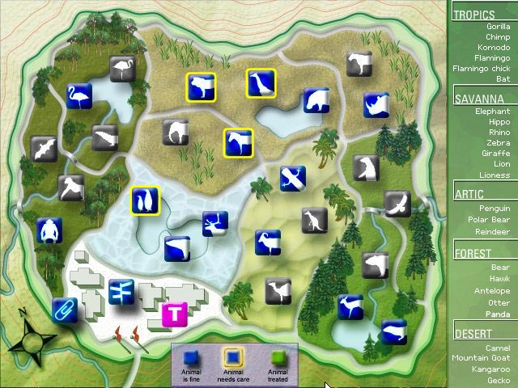
The HE Environment

Slide 4
How do we teach an unfamiliar subject?
Remember…
You are not giving a research paper or teaching at PhD level
You are a specialist in your discipline and a trained academic
You are there to guide your students in their own learning, not to provide them with every possible bit of knowledge

Slide 5
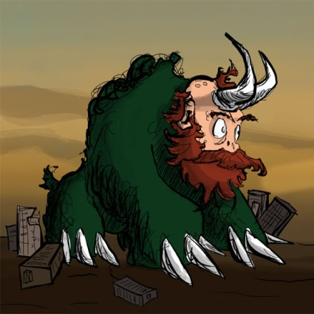
Preparing to Teach
Ask your colleagues for advice
Do some research around the topic
Is there any documentation from previous years?
Can you use any of your previous knowledge? (subject-specific and academic skills)
Remember that you only need to be one week ahead of your students
Maybe surprising: It is easier to stay focussed in an unfamiliar subject!

Slide 6
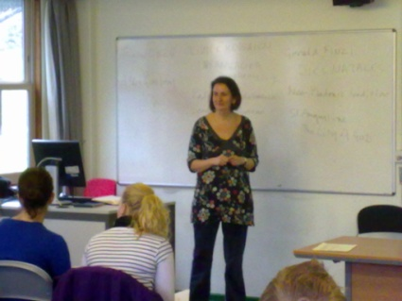
In the classroom
Be prepared and trust yourself.
Make sure that you understand the subject of the day (otherwise ask a colleague).
Be aware how much new material your students can cope with in one day and plan your classes accordingly.
Try to have one more layer of knowledge than the one you aim for in class.
Acknowledge when you do not know something, but check it up and feed the answer back to the students.
Enjoy yourself, as your fun in learning something new can infect your students.

